Slide 1
Free-form Friday – Putting Courses on the Learn Center
Notes:
Hello and welcome to the second Free-form Friday. My name is Amy Foster and I’ll be going over how to put courses in the Learn Center.

Slide 2
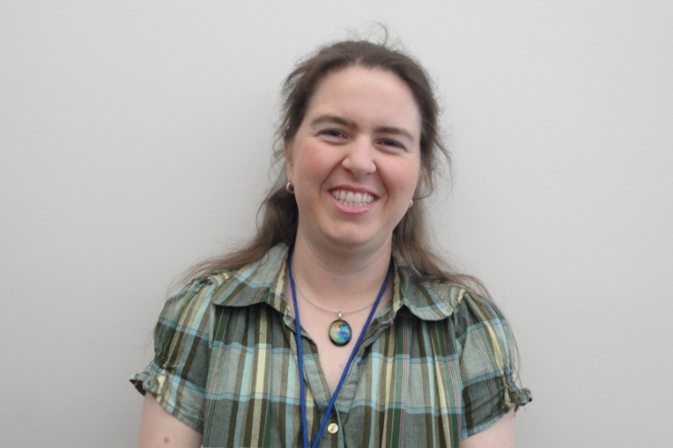
Who am I?
Amy Foster
Online Course Developer
Sales & Service Readiness
With IGT since 2001

Slide 3
Agenda
What are courses?
What is SCORM?
Gathering information
FTP course materials
Create a new course
Insert a course
Edit courses
Attach a test
Insert SCORM course
Post the course
Notes:
Let’s go over our agenda for today. First we’re going to talk about what courses are and we’re also going to discuss SCORM. Then we’ll discuss all the steps involved in actually putting a course on the Learn Center – gathering information about the course, FTPing the course materials to the server, creating a new course in the Learn Center, Inserting a course, editing courses and attaching a test. Then we’ll briefly discuss inserting a SCORM course and then talk about how the courses actually get made available to users.

Slide 4
What are courses?
On-demand web-based training
Accessed through the Learn Center
Users receive credit
Types of Content
AT&T Connect Event Recordings
Interactive Material (Articulate)
Tests
May be required for completion
Built in Learn Center & attached to the course
Notes:
How many of you have taken a self-paced course through the Learn Center?
OK so you know what they look like. {OK, let's take a look at one - Patron Management Marketing Workbooks (AT&T no test), What's New in Advantage v8.2 sp7 (Articulate test)}
Let's start by talking about what courses are. A course contains our on-demand web-based training in the Learn Center so that it can be accessed and so that users can receive credit for taking it. The course shell is provided by the Learn Center and we put the content into it that we want the user to access.
There are basically two types of content we currently use on a regular basis. We use recordings from AT&T Connect and we use interactive material we create in Articulate. We have used other content in the past and as our online courses evolve, the content will probably change again. However, you'll see that the course shell is the same.
Most of our courses include a test that is used for completion. Tests can be built in the Learn Center and attached to the course. I'm not going to go over how to build tests in this session, but I will discuss how to attach a test that has already been built.

Slide 5
What is SCORM?
Shareable Content Object Reference Model
Set of standards web content should adhere to
Allows test information to be built into material
Test score is sent to the Learn Center
Do not have to build a test in the Learn Center
SCORM content must live on Learn servers
Limited space
Classes vs. courses
Notes:
We're going to discuss SCORM a little. SCORM stands for Shareable Content Object Reference Model and specifies standards that web content should adhere to. Some of our content is SCORM compliant. This allows us to deliver a single object to the user that includes test material. This presents a seamless interface to our user rather than presenting the material and then requiring them to navigate through the Learn Center course to the test.
All of our SCORM content has to live on servers provided by Learn and we have to be careful with the space. Anything that's not SCORM can live on IGT servers so most of our content is not SCORM. SCORM courses are not created in the same way as regular courses are but once they've been created they look the same and can be edited in the same way.
One other thing you should know about SCORM content is that you can create a class that holds multiple courses. In the Learn Center, a course can be created as a regular course or as SCORM. A class is always SCORM and always contains multiple courses.

Slide 6
Gathering Information
Name of course
Short description
Duration of course
Format of course
Is there a test?
Location of event materials
Notes:
Before you go into the Learn Center to enter the course, you need some information. You need the name of the course, a short description, the duration of the course if it's an AT&T Connect event, what the format of the course is, and whether there is a test. You also need the location of the event materials. I usually find it easiest to open notepad and pull all of the information together there. Usually I get this information in an email from whoever created the course material. I usually copy and paste just the information I need into Notepad so that I verify that I have everything I need before I start.

Slide 7
FTP Course Materials
Event Materials & Supporting Materials
Igtproducts server
Core FTP Lite (App Share)
replace “/igtproducts/wwwroot” with “http://www.igtproducts.com”
Notes:
The event materials, including any supporting materials, need to be ftp'd to the igtproducts server if they're not already there. I use Core FTP Lite which is free and easy to use. You just open the software and choose igt products. On the left side of the window, navigate to the desired file and on the right side, navigate to the folder you want to put it in, then click the arrow. Once you've uploaded the file, right-click on it and choose properties. Copy and paste the file name into your information file. You have to change the first part of the file name to www.igtproducts.com.

Slide 8
Create a new course
Open the Control Panel
Templates
Articulate Template – used if the course is contained in an Articulate shell
AT&T Connect OD Course Template – used if the course has multiple AT&T Connect events and a test
AT&T Connect OD One-part Template – used if the course has only 1 AT&T Connect event and a test
AT&T OD One-part template no test – used if the course has only 1 AT&T Connect event and no test
Notes:
Now you have all the information you need to put the course into the Learn Center. Now we're going to login to the Learn Center and access the control panel. Scroll down to the bottom of the page and enter the management password - igtigt. When the management menu comes up, click Control Panel.
There's a menu on the left side, scroll down to Courses. We have templates setup so to create a new course, choose copy existing course. Click Select course and in the filters section, enter template for course name. This will bring up 4 templates. The Articulate template should be used if the course material was created in articulate. If the course material is an AT&T Connect event, you have 3 choices. Normally, there is only one event per course - if there's a test, use the AT&T Connect OD One-part Template. If there is no test, use the AT&T OD One-part template no test. If there are several AT&T Connect Events that the student will need to view as part of the same course, use the AT&T OD Course Template.
Once you've selected the correct template, click Return Selected. Enter the New course name (you can copy and paste from your information document) then click Select Authors and search for yourself. Then create the course.

Slide 9
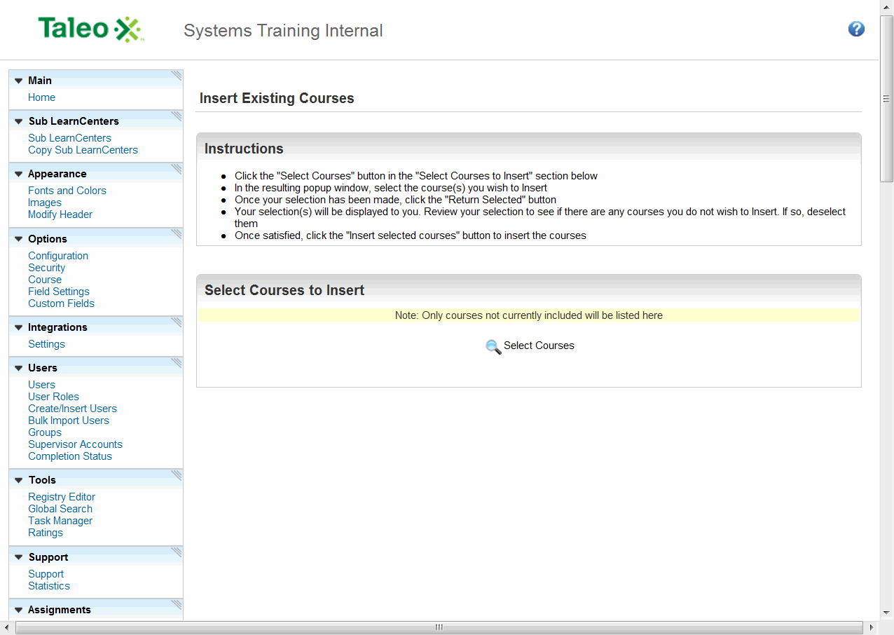
Insert a course
Created in Warehouse
Move to Showroom
Notes:
Once the course is created, it is still not available to users until it has been inserted. Basically it resides in a "warehouse" and needs to be moved to the "showroom." To insert the course, go to the Course menu and choose Insert Existing Course. Select Courses and search for the course. You also need to edit the course - if you click on the course name at this point, the course will open and you can edit it. Before I move on to editing, I'm going to finish inserting the course.

Slide 10
Edit Courses
Notes:
Now let's go back to the course and edit it. If you click the Pencil icon, a wysiwig editor appears. All you need to do is copy and paste the information you set up earlier into the appropriate spots. To insert the course content, right-click the link, choose link, then Properties. Delete the url and copy and paste the new url into that field. One thing you need to be careful of - if the link does not start with http, this field will change to Other. If I click OK now and then Save Changes, when I test the link, I get this error. You need to make sure the field is changed back to http and the link will work correctly. When I write down the url I add the http but often when I get it from someone else, they start at the www so keep this in mind. Also, I always test the links on the page.
Ok, now let's look at an Articulate course. It's actually simpler than the AT&T Connect courses but you do have to go into the html code and change one thing. Some courses have supplemental materials - if so, just replace the placeholder information here with the materials. If there are no supplemental materials, just delete the column. Right-click and choose Table, then Remove Columns. Once you're finished with the supplemental materials, you need to insert the link for the articulate material. In order to do that, you need to go into the html code. Click html at the bottom of the window. The code is pretty short and all you're looking for is the phrase "copy player url here." Select the whole phrase and only the phrase and copy and paste the url for the player. Click Save Changes and the course will come up with the movie. Check the links for the supplemental material.

Slide 11
Attach a test
Notes:
Now that you've created the course, edited it and inserted it, you'll need to attach the test. Hopefully in a future class, I'll go over creating tests, but for now we'll assume that someone has created the test and given you the name of it. In the Control Panel, find the Assessments/Surveys option and choose Instances. Click Create Instance. First you need to Select the Assessment. The Instance name can be the same as the course name. We have specific text for the pre and post instructions and I always copy and paste it. It's in the handout I'll be sending you. You need to associate the instance to a course and then Select the Course. If you've forgotten to insert the course, it won't show up when you search for it and you'll have to go do that then come back and do the instance. Then there are a bunch of options you need to fill in - all of this is in the handout.

Slide 12
Insert SCORM course
Notes:
That's how to create a normal course. Let's talk about SCORM courses. The files for the SCORM course need to be ftp'd to the Learn server in the same way you would ftp a normal course to the igtproducts server. In this case, you need to know where the imsmanifest file is. Choose the SCORM Class Importer and enter that location into the File Path field. Click Continue Import. Click Continue Import again on the next screen. The next screen has a bunch of options - this information is in the handout and you just need to fill it all in and click Continue Import. The course will open and you'll notice that this is the same course shell as the other courses. If you need to edit anything you can edit it in the same way. You also need to Insert the course the same way we did before.

Slide 13
Post a course
Posted on Self-paced courses page
Admin Assistant
Technical Internal Learn Center – sent out as assignments
Technical Department Admin
Notes:
Now that you've attached the test the course is ready to be posted. The admin normally posts all the courses on the self-paced courses page. If you're posting a course to the Technical Internal Learn Center, their admin sends them out as assignments. So you need to let them know you've added a course.
If you are adding a course that needs to be in more than one Learn Center, you only need to create it in one. Then go into the other Learn Center and Insert Existing Course. If it has a test, the test needs to be created and attached in each Learn Center.

Slide 14
Summary
What are courses?
What is SCORM?
Gathering information
FTP course materials
Create a new course
Insert a course
Edit courses
Attach a test
Insert SCORM course
Post the course

Slide 15
Questions
Any Questions?

